Slide 1
Generative project
“Donald Trump quotes”
Mark Erokhin (mark.erokhin@study.thws.de);
Anastasiia Demidova (anastasiia.demidova@study.thws.de)

Slide 2
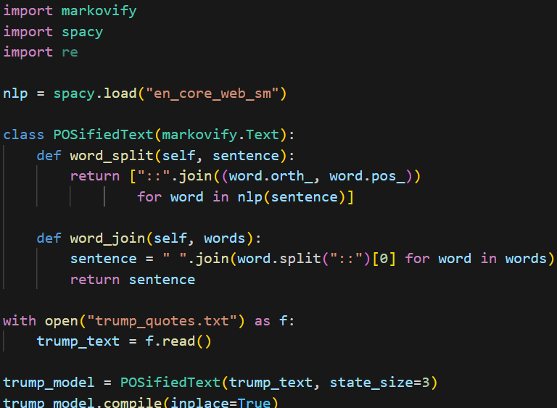
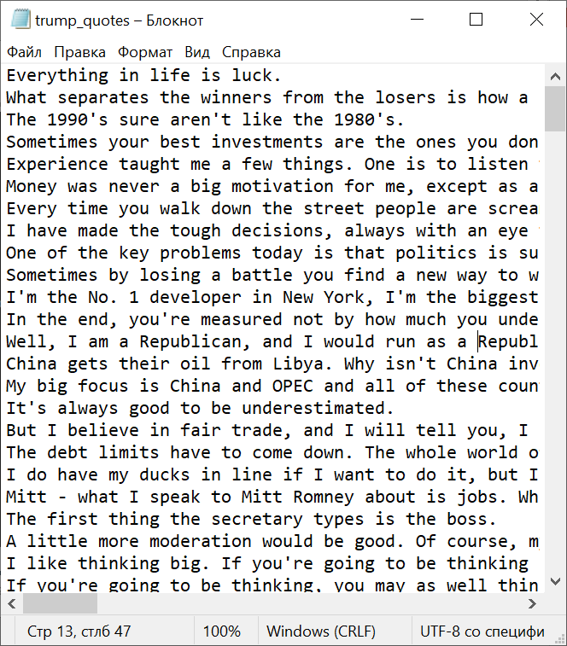
Code and input text examples

Slide 3
Generated quotes – Best examples
The Arab League tells us to go in and take over the Vatican ?
It 's not that they have to be great for the United States .
My opponent asks her supporters to recite a different pledge .
It 's artistic , from my standpoint , and I 'm very strongly against tax increases .
Sometimes your best investments are the ones you do n't have a lot of money .

